Slide 1
A New Generation of Agriculture: The Rise of GIS and Precision Farming, an Ohio Case Study
Alexandria Horne
Farm Manager Horne Family Farms
Senior Computer Programming Analyst Cincinnati Area Geographic Information System (CAGIS)
2016 Ohio GIS Conference
September 28 - 30, 2016 | Hyatt Regency Columbus| Columbus, Ohio

Slide 2
Presentation Outline
Introduction to precision farming
Case Study: fertilizer prescription map creation
USDA Open Data Portal
ArcMap Demonstration

Slide 3
An approach to farm management that uses technology to ensure that crops and soil receive exactly what they need for optimum health and productivity.
What is Precision Farming/Agriculture?
Data Collection
Analysis
Farming
Management Decisions

Slide 4
The goal is to ensure profitability, sustainability and environmental conservation
“A smorgasbord of technologies”
Variable Rate Technology
Direct & Remote Sensing
Precision Navigation
Real-time Monitoring
Global Positioning Systems
Geographic Information Systems

Slide 5
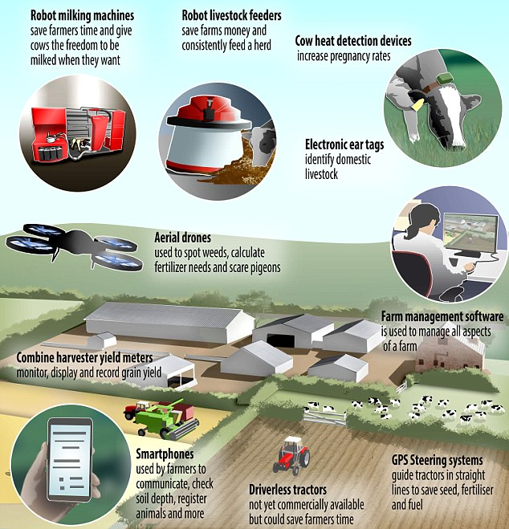

Slide 6
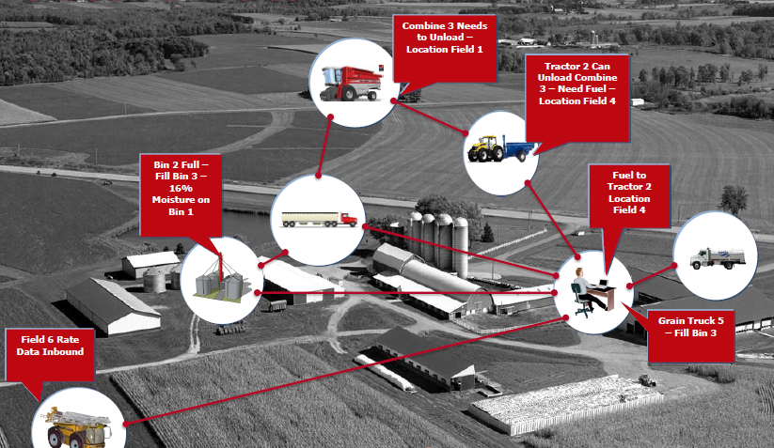
Precision Operation Example

Slide 7
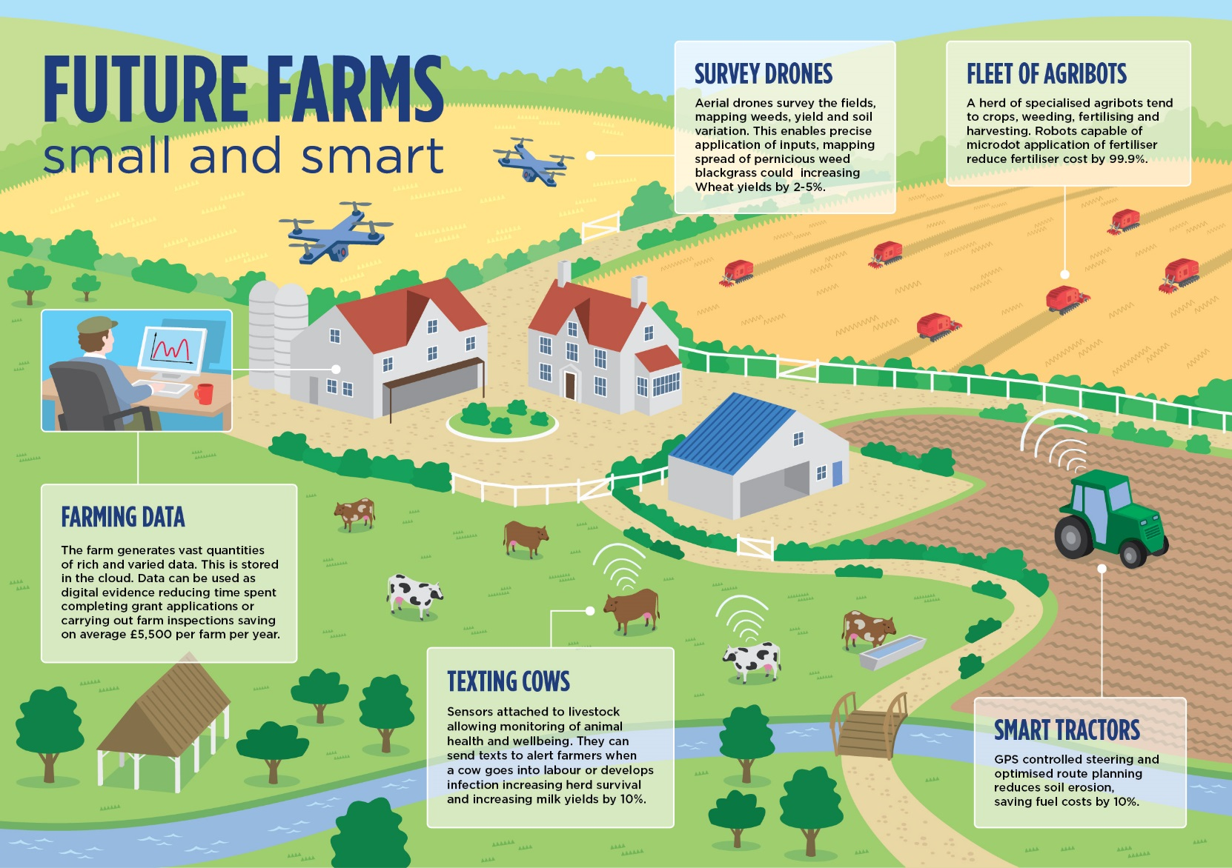

Slide 8
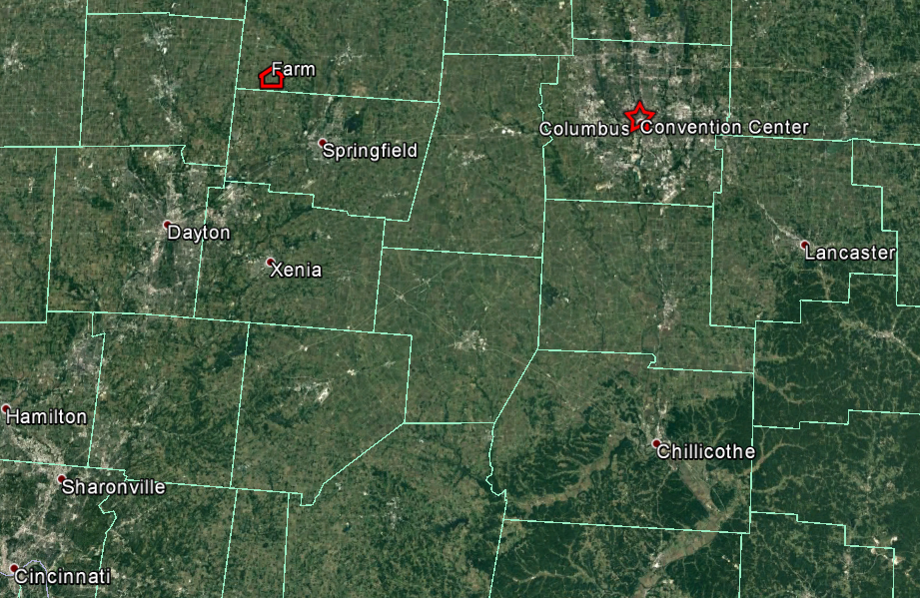
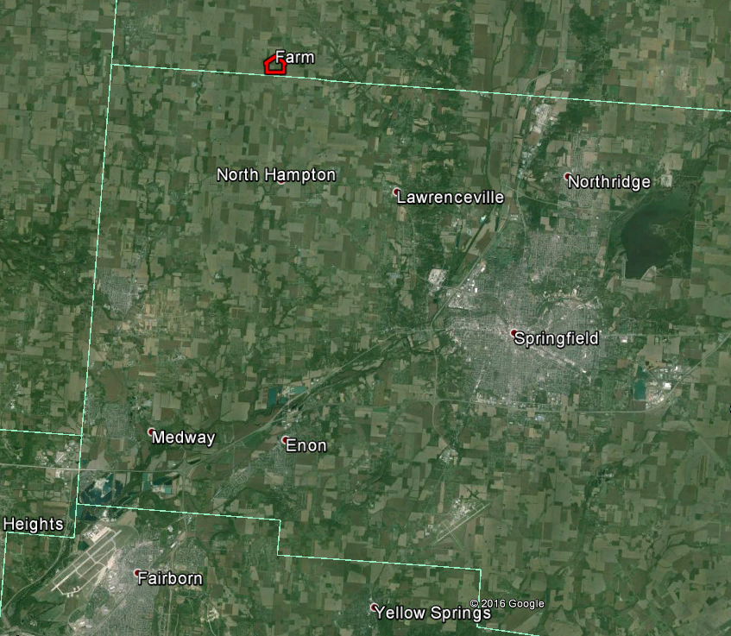
Case Study – Horne Family Farms
- Family-run farm located just outside of Springfield, Ohio
500 arable acres
Corn (field)--cover--soybean rotation system
Conservation tillage system (Spring only disk pass)

Slide 9
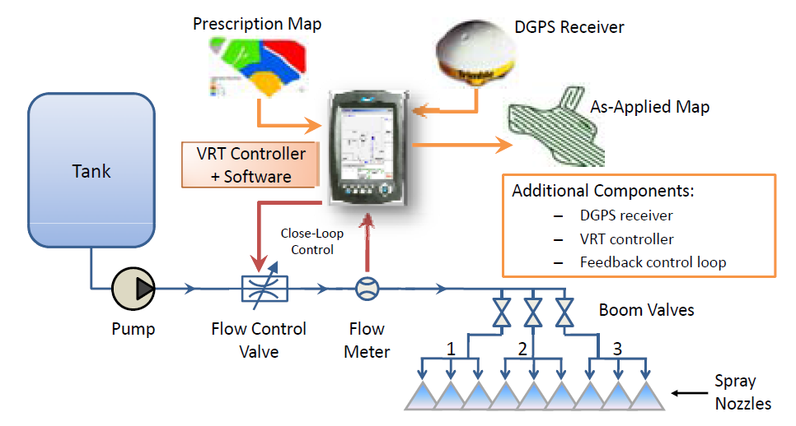
How VRT Works

Slide 10
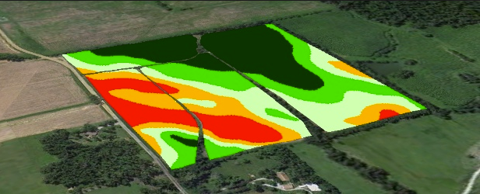
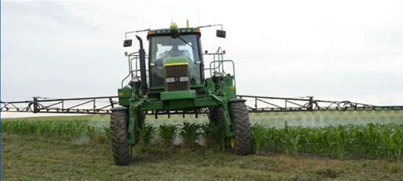
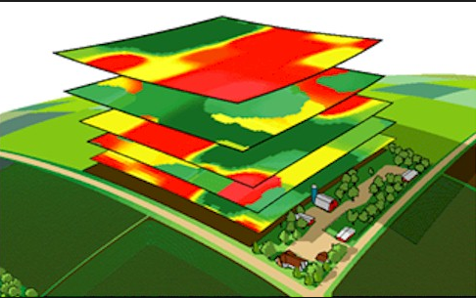
Variable Rate Technology (VRT)

Slide 11
Fertilizer Prescription Map Creation
GIS based input into VRT system software
Tells nozzles when/where to spray and at what rate/coverage
2 maps: Phosphorous (P)
Potassium (K)
Resources used ArcMap 10.3 Garmin handheld GPS unit (Basecamp software) Google Earth USDA Web Soil Survey

Slide 12
Steps to create prescription maps
Determine soil sample locations (grid based)
Take soils samples at designated locations
Send to lab for analysis
Input soil sample results (point attributes)
Calculate needed fertilizer rates (raster prescription maps)
Convert raster into classified polygon layer then export data
Load this data into precision equipped tractor for VRT application

Slide 13
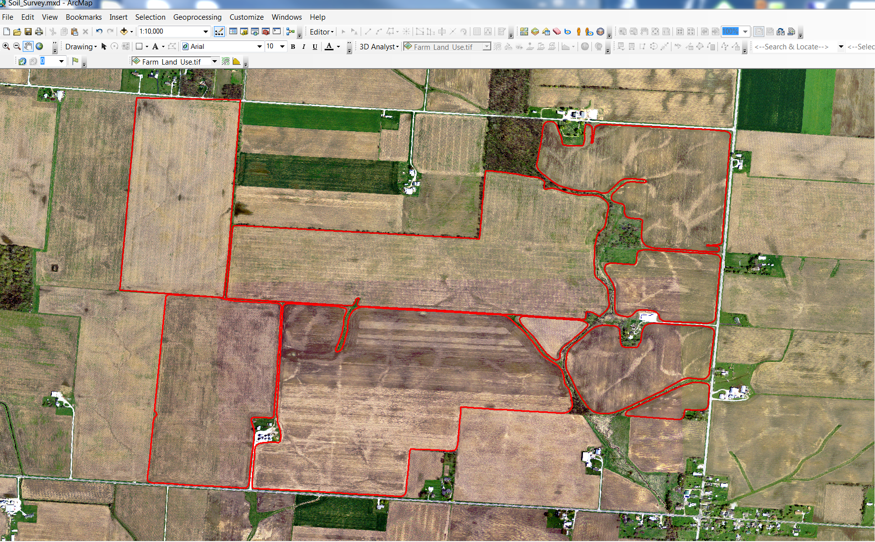
Field Boundaries (ArcMap)

Slide 14
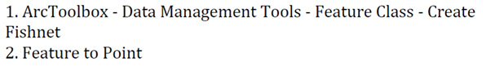
Creating a systematic soil sampling grid

Slide 15
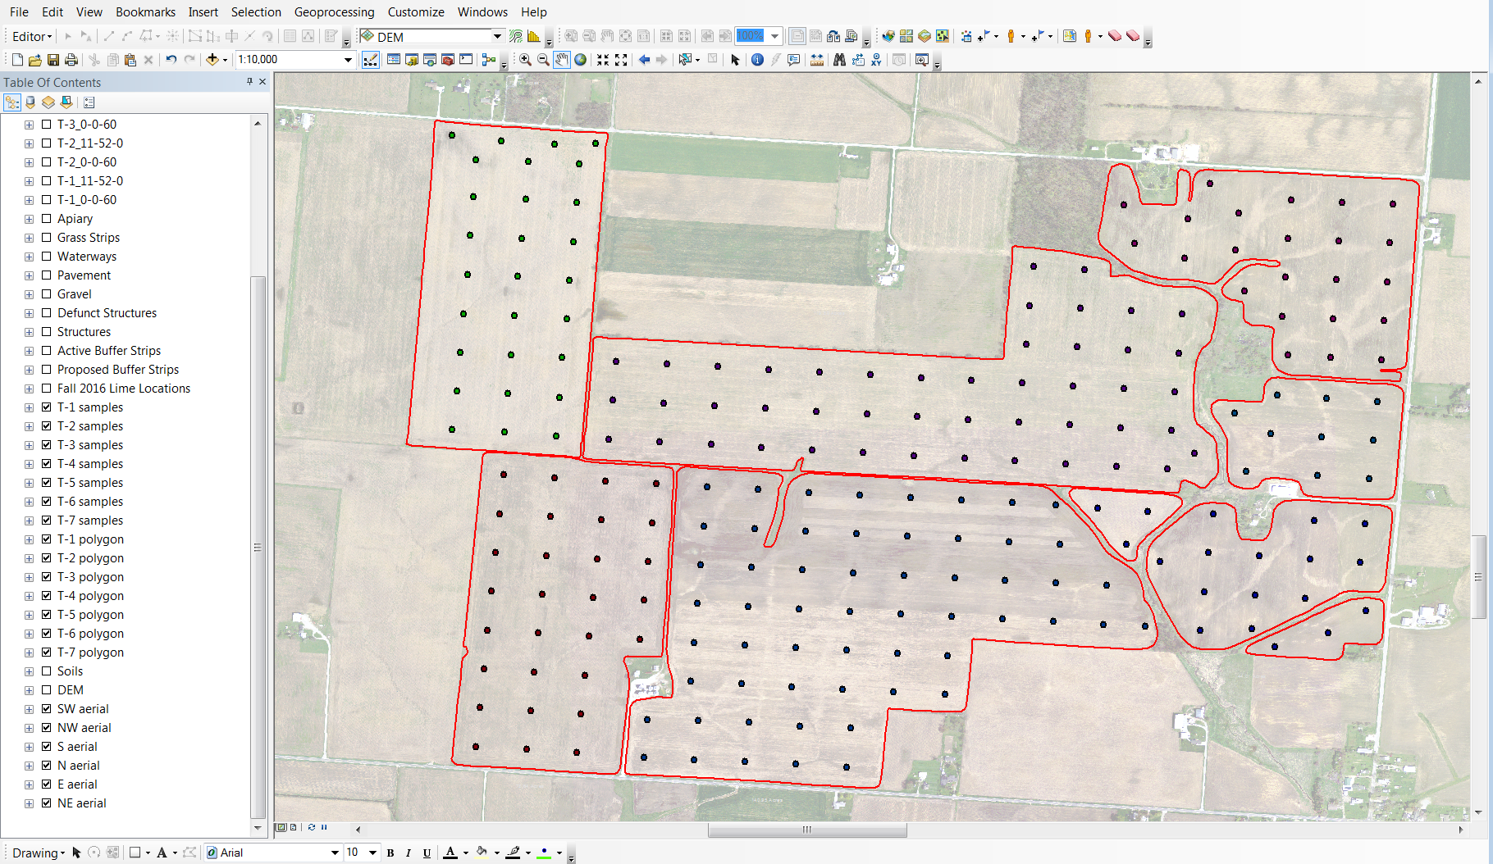
Completed soil sample grid based map

Slide 16
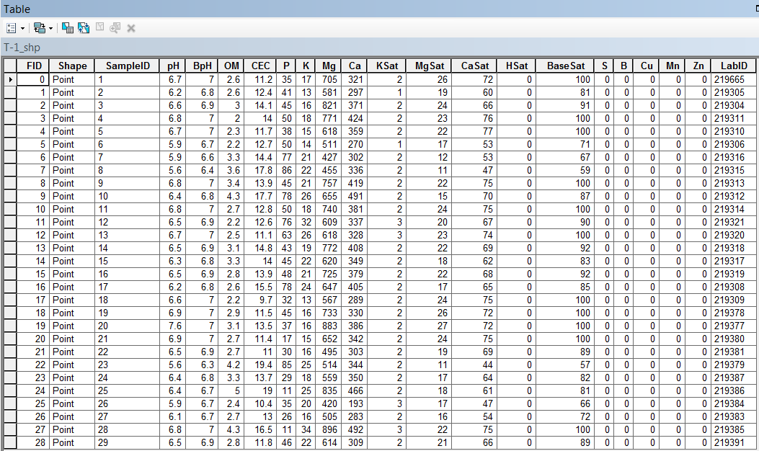
Input soil sample results

Slide 17
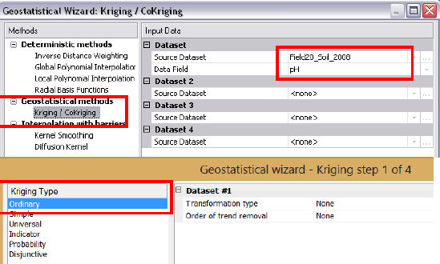
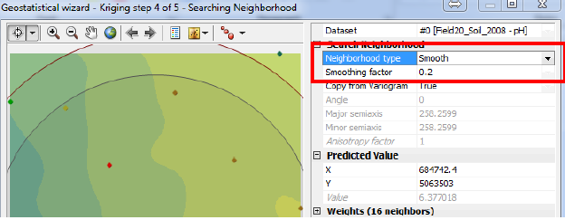
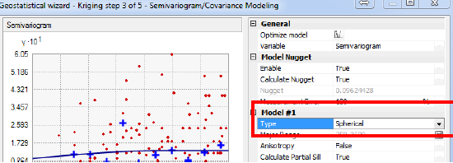
Interpolating soil sampling data
Ordinary Kriging (Geostatistical Analyst )

Slide 18
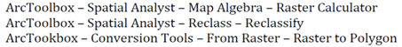
Developing a phosphorus fertilizer prescription map

Slide 19
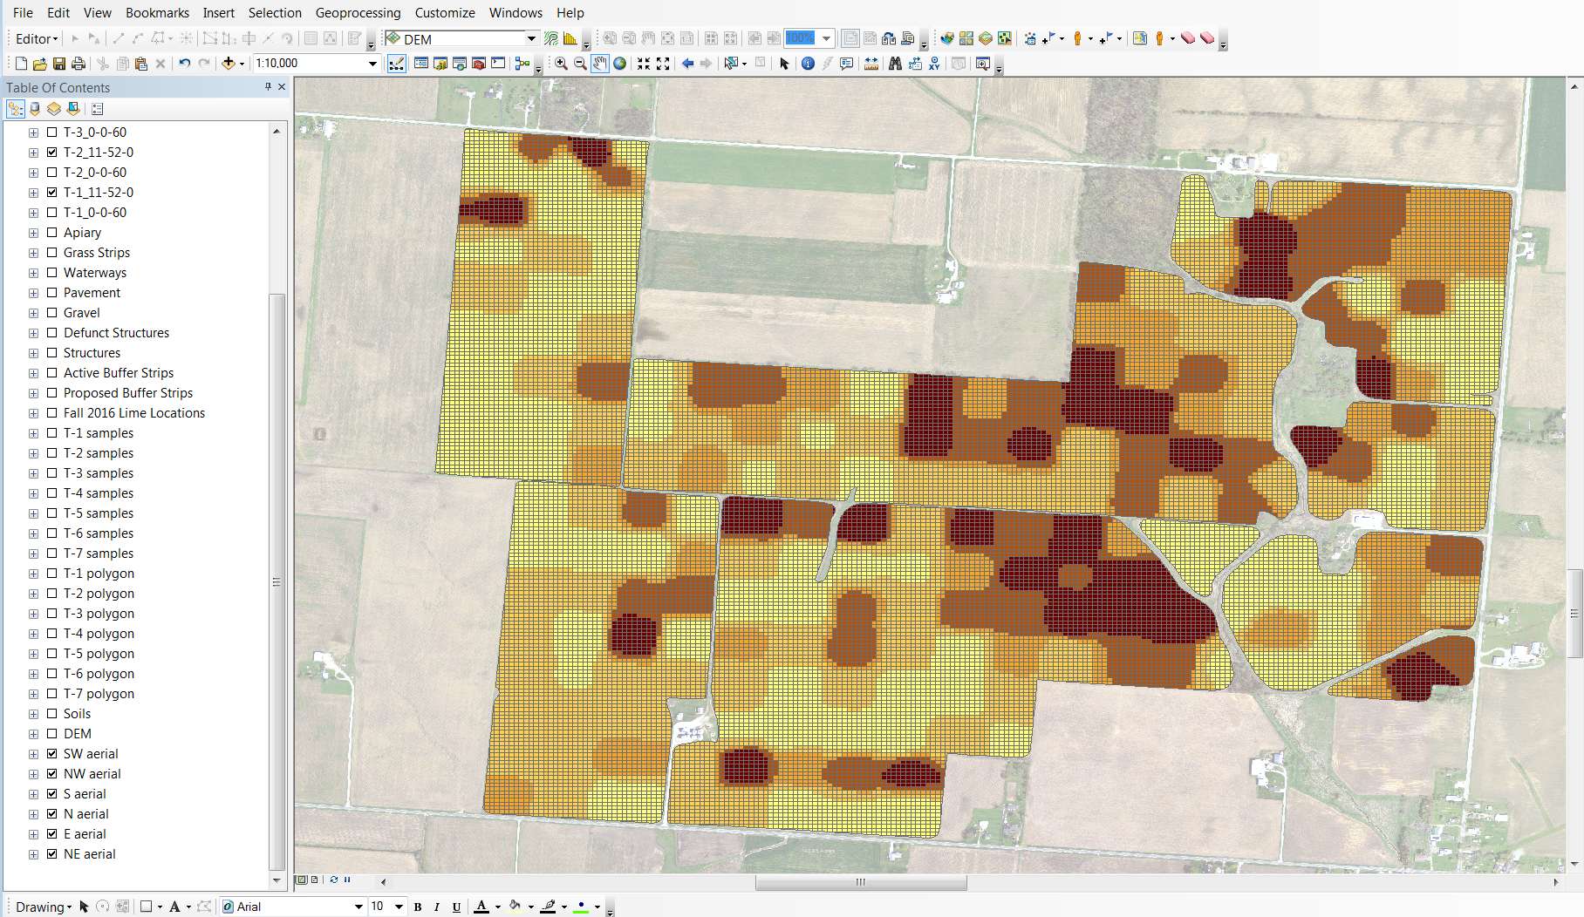
Phosphorous Prescription Map

Slide 20
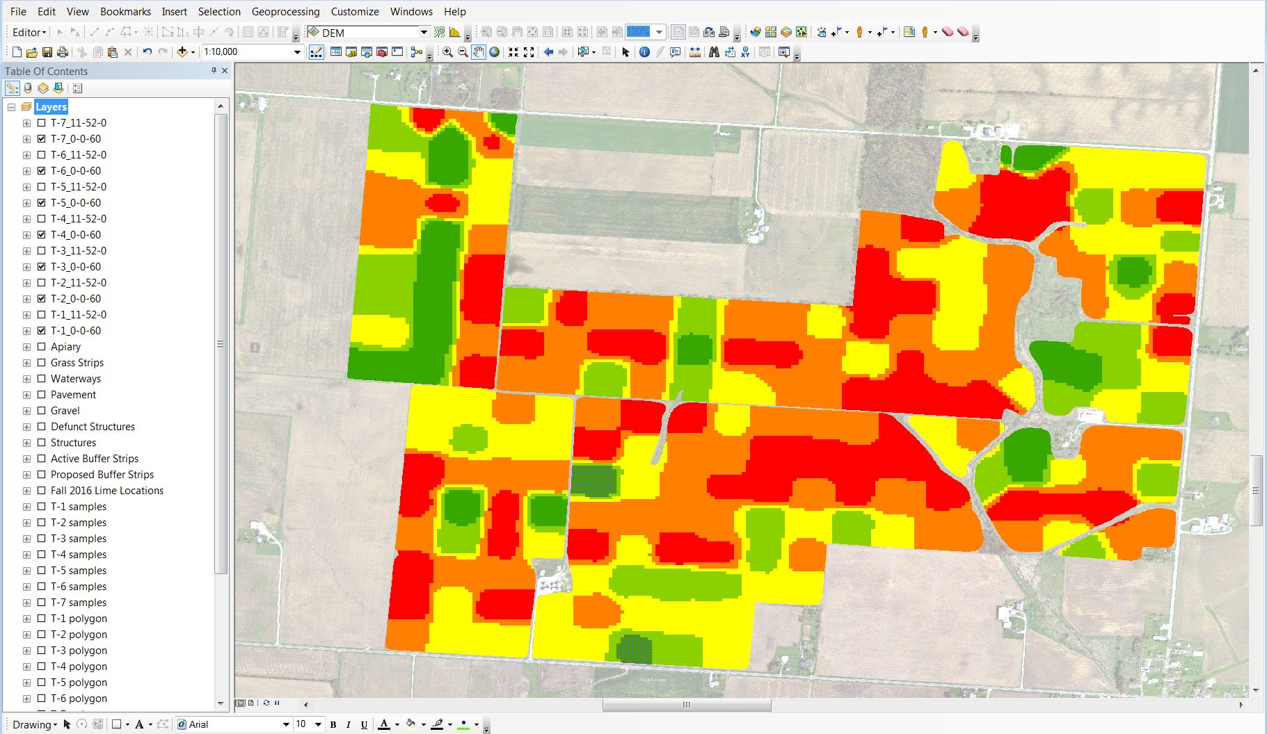
Potassium Prescription Map

Slide 21
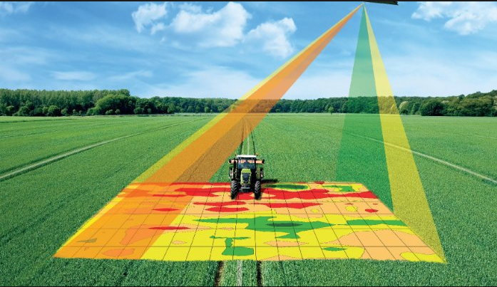
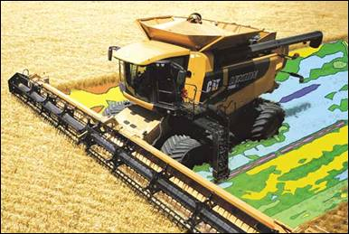
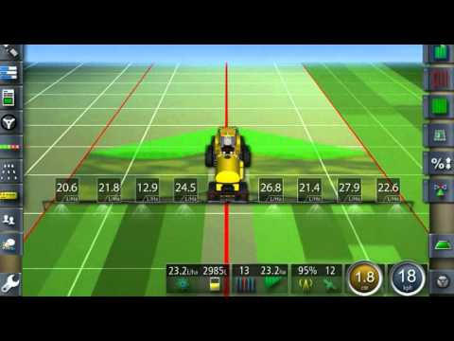
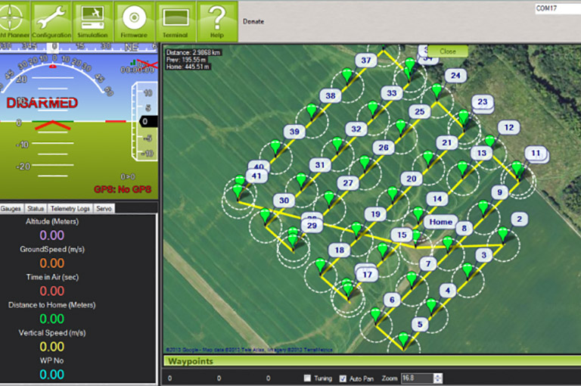
Crop Spec software

Slide 22
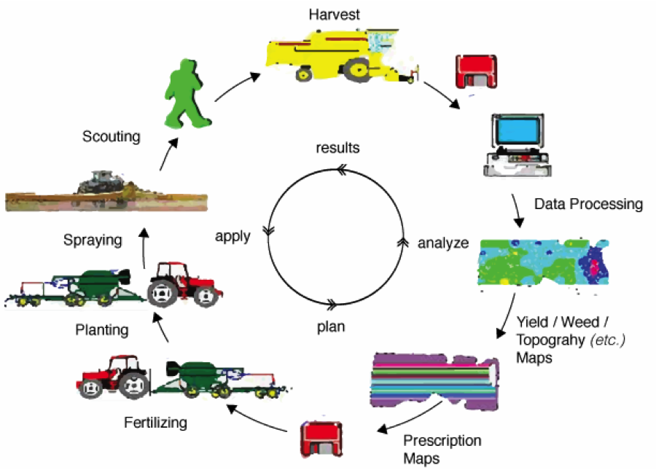

Slide 23
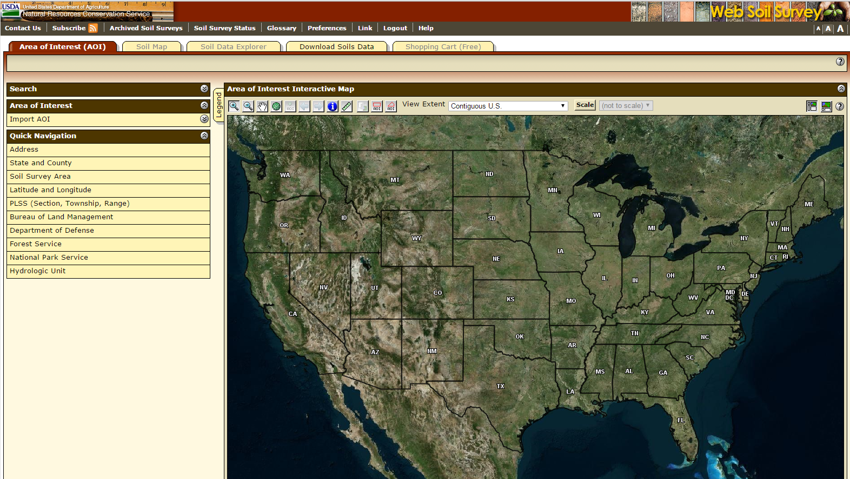
USDA Web Soil Survey
Specify an area of interest (AOI) polygon and examine the soil properties of that AOI
http://websoilsurvey.sc.egov.usda.gov/App/WebSoilSurvey.aspx

Slide 24
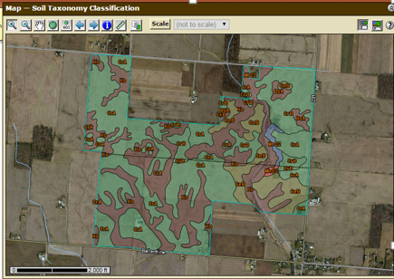
Soil Taxonomy Classification of AOI

Slide 25
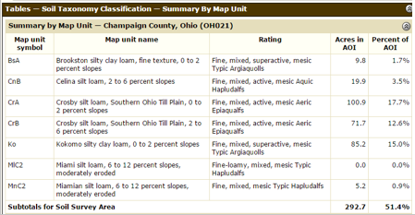
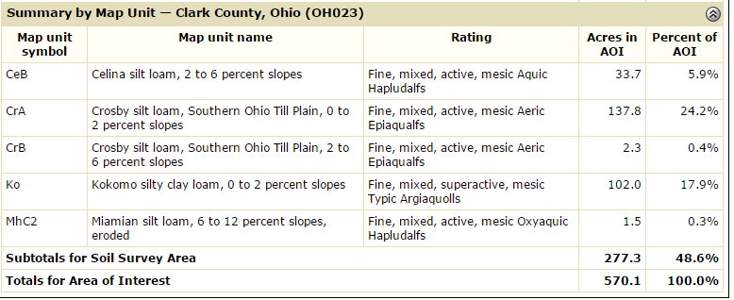

Slide 26
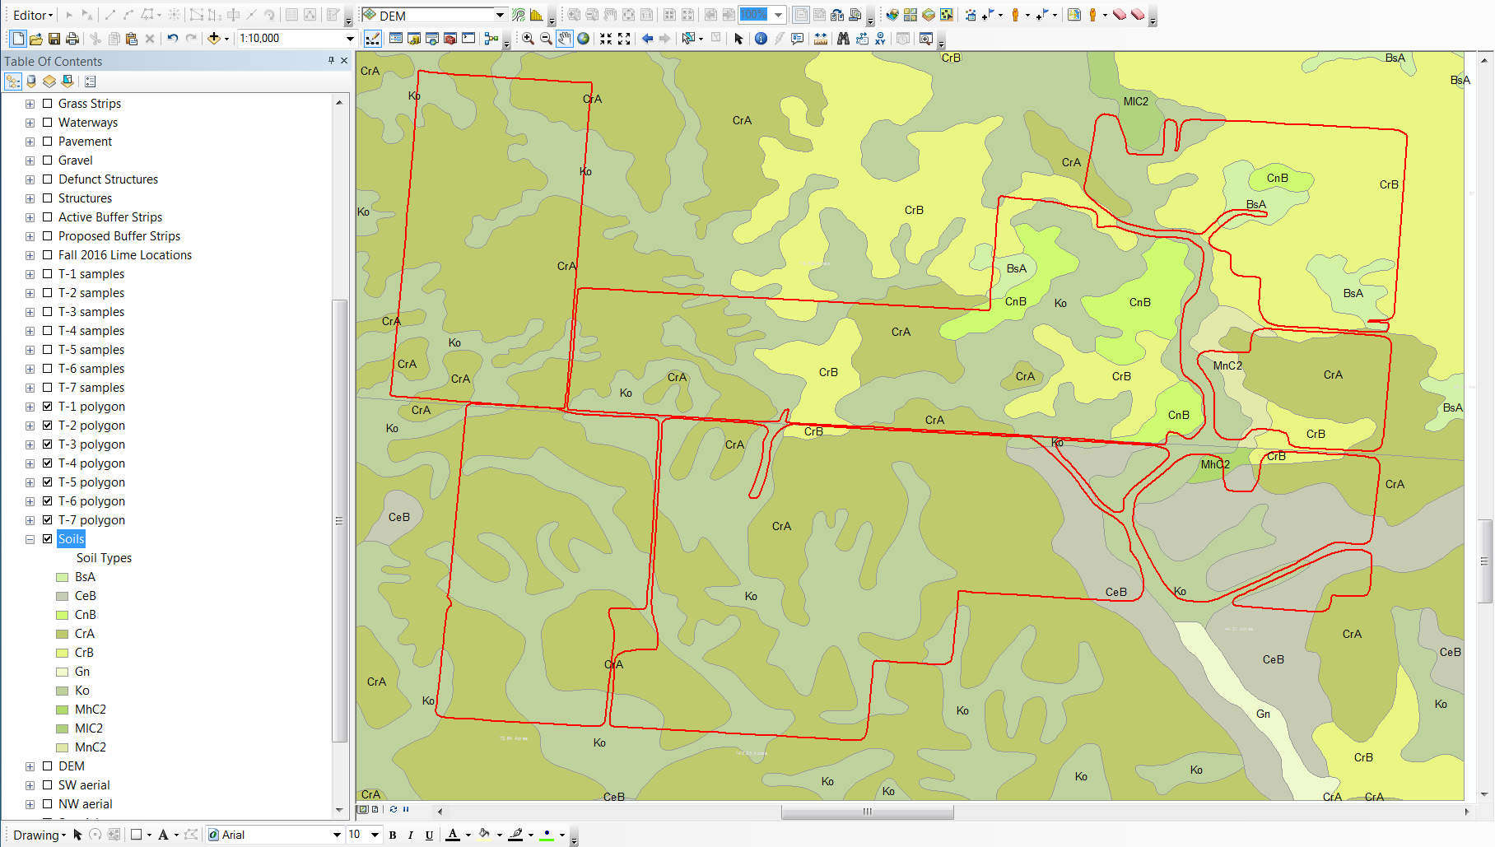
Download data for integration into ArcMap

Slide 27
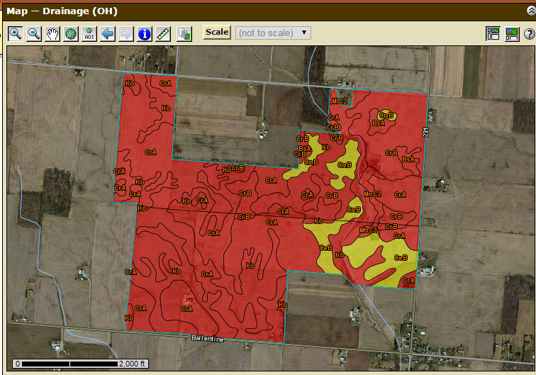
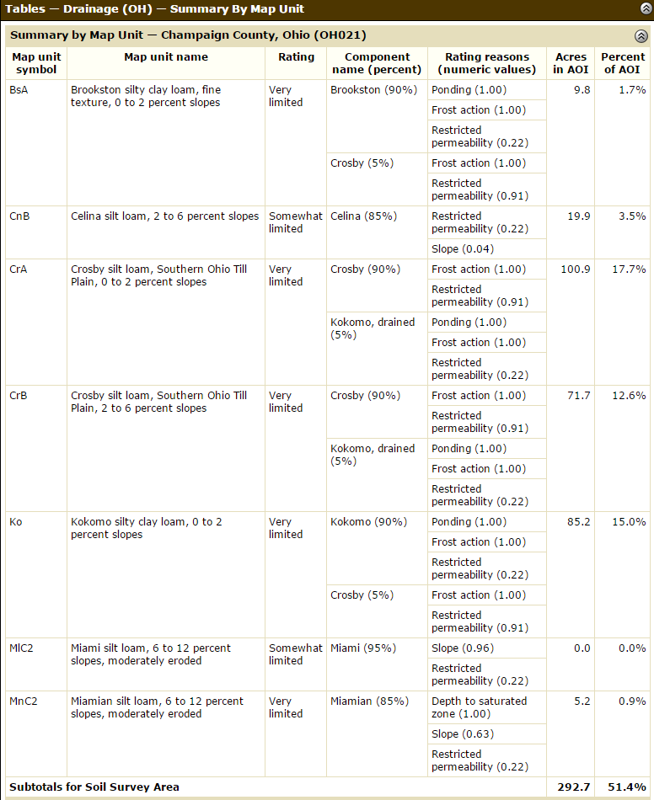
Soil Drainage Behavior of AOI

Slide 28
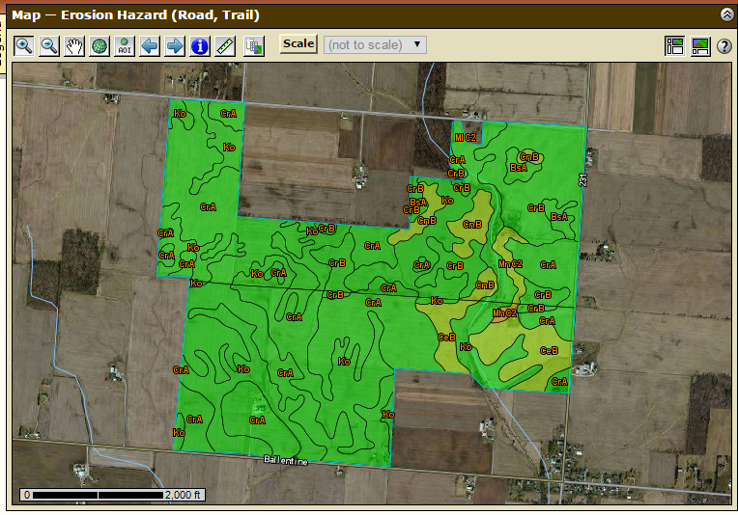
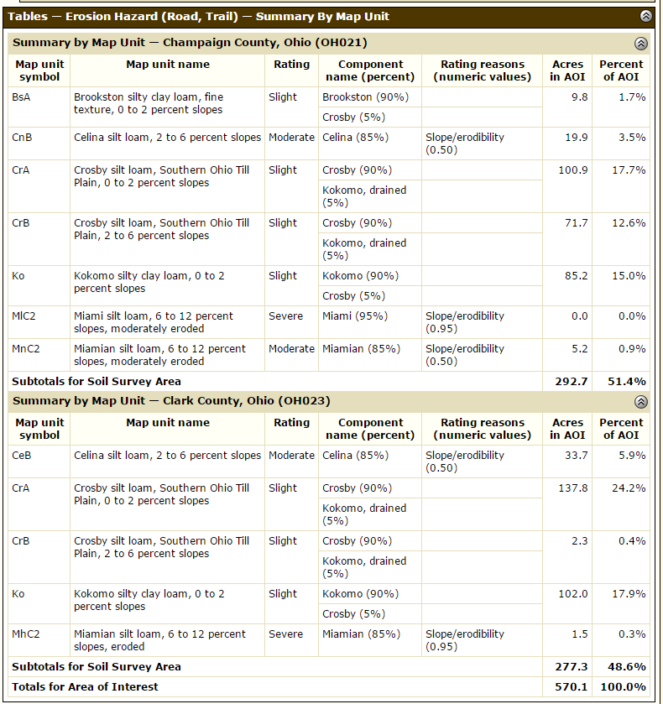
Soil Erosion Potential of AOI

Slide 29
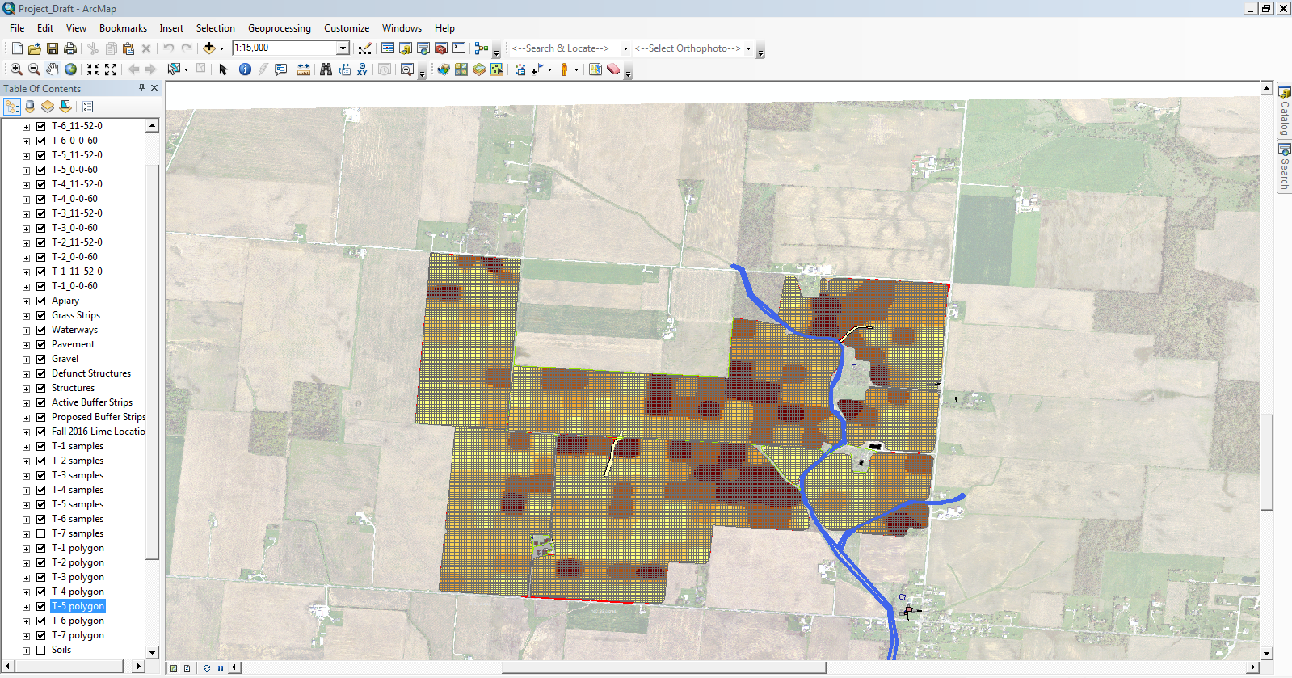
ArcMap Demonstration

Slide 30
Thank you for your time! Are there any questions?
Alexandria Horne
alexandria.horne@cincinnati-oh.gov horne.alexandria@gmail.com

